Slide 1




Artificial Intelligence Training
Multi-Tiered AI & Data Management Training Program for Northern Command

Slide 2
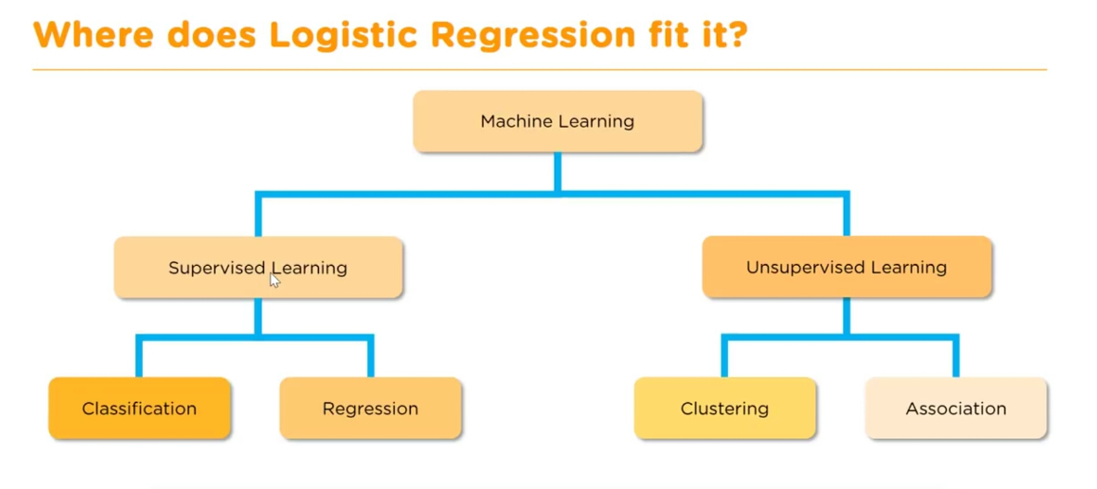

Where logistic regression fits?
Logistic Regression – Supervised Learning
It’s a classification model
01

Slide 3
What is Logistic Regression?
Logistic Regression is a supervised learning algorithm used for classification problems.
Instead of predicting continuous values (like Linear Regression), it predicts probabilities that map to classes (0 or 1).
Example: Predict whether a student passes (1) or fails (0) based on study hours.
02

Slide 4

Equation of Logistic Regression
p(y=1∣x)p(y=1|x)p(y=1∣x): Probability of belonging to class 1
e: Euler’s number (~2.718)
β0​: Intercept
β1​: Coefficient for feature x
03

Slide 5
Why Logistic Regression?
Simple and efficient for binary classification.
Works well when the relationship between features and outcome is approximately linear in the log-odds space.
Probabilistic output (not just class labels) helps in decision making.
Easy to interpret and computationally inexpensive.
04

Slide 6
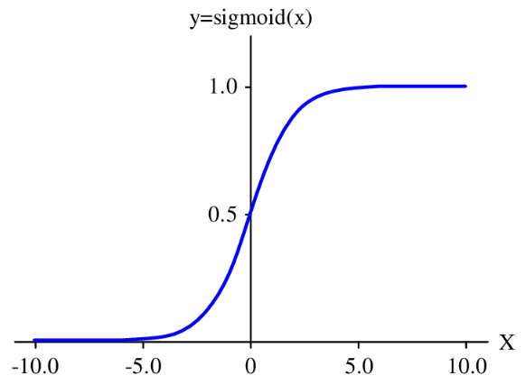
Intuitions of Logistic Regression?
Instead of drawing a straight line like Linear Regression, Logistic Regression uses the Sigmoid Curve.
The sigmoid ensures output always lies between 0 and 1.
Threshold (commonly 0.5):
If probability ≥ 0.5 → Class = 1
If probability < 0.5 → Class = 0
05

Slide 7

The Sigmoid Function
Output always between 0 and 1.
Converts linear values into probabilities.
"S-shaped" curve.
06

Slide 8
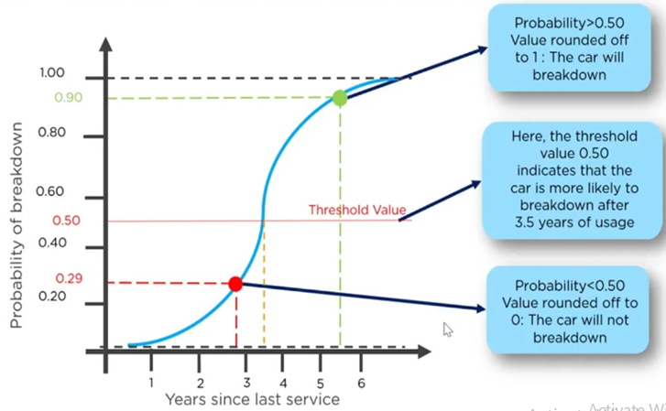
Let’s take some analogy case to understand
Imagine it’s been a few years since you serviced your car
In x-axis – You’re marking years since last service
In y-axis – you’re marking the probability of breakdown
07

Slide 9
Let’s work-out on simple dataset
Hours (X) | Pass (Y)
1 | 0
2 | 0
3 | 0
4 | 0
5 | 1
6 | 1
7 | 1
8 | 1
9 | 1
10 | 1
Linear Function: Compute z=β0+β1⋅X
Apply Sigmoid: Convert z into probability
08

Slide 10

Let’s work-out on simple dataset
Hours (X) | Pass (Y)
1 | 0
2 | 0
3 | 0
4 | 0
5 | 1
6 | 1
7 | 1
8 | 1
9 | 1
10 | 1
Decision Rule:
If p≥0.5p → predict Pass (1)
Else → predict Fail (0)
Training (Learning Parameters):
Use Maximum Likelihood Estimation (MLE) to find best β0,β1
Minimize Log Loss (Binary Cross-Entropy):
09

Slide 11
Hyper parameters in logistic regression
Penalty (regularization):
l1 (Lasso): feature selection
l2 (Ridge): prevent overfitting
C (inverse of regularization strength): Smaller C → stronger regularization
Solver: Algorithm used for optimization (liblinear, saga, newton-cg, etc.)
Max_iter: Maximum number of iterations allowed for convergence.
02

Slide 12
Let’s dock this study with defence scenario
In real missions, different types of operations (skirmish, ambush, full assault) consume ammo in different patterns:
A skirmish → short duration, fewer rounds, small enemy size.
An ambush → medium duration, sudden heavy fire, moderate enemy strength.
A full assault → long duration, large rounds, big enemy size.
So the ML task here is:
Given inputs like ammo type, rounds used, terrain, attack duration, and enemy strength…
Classify what type of mission it most likely was (skirmish, ambush, full assault).
10

Slide 13
What we’re classifying ?
We’re teaching the ML model to recognize which kind of mission a soldier group was engaged in, just by looking at the ammo usage and contextual features.
Target label: mission_class
Classes: skirmish, ambush, full assault
We’re teaching the ML model to recognize which kind of mission a soldier group was engaged in, just by looking at the ammo usage and contextual features.
11

Slide 14
How this model helps with defence group?
Operational insight → Helps officers see how data-driven models can recognize mission patterns from raw usage data.
Planning & logistics → If we can classify past missions accurately, the same model can predict expected mission type during planning and assist in ammo allocation.
Training demo → Shows how to take battlefield-style logs and convert them into a classification problem (a very core ML workflow).
Engagement → The “mission class” resonates with officers more than abstract dataset labels like “Iris flower types.
12

Slide 15
Pros of logistic regression
Simple, fast, and interpretable
Outputs probabilities (useful for risk analysis)
Works well with linearly separable data
Less prone to overfitting if regularized
13

Slide 16
Limitations of logistic regression
Assumes linear relationship in log-odds space
Not suitable for very complex datasets (non-linear boundaries)
Struggles with high-dimensional or highly correlated features
Works poorly if classes are highly imbalanced
14

Slide 17
Hands-on: Ammunition Usage Optimization
Hands-on code to explore logistic regression with ammunition usage dataset
15

Slide 18
Support Vector Machine

Slide 19
What is Logistic Regression?
Used for Classification as well as Regression problems. However, primarily, it is used for Classification problems in Machine Learning.
Goal is to create the best line or decision boundary that can segregate n-dimensional space into classes so that we can easily put the new data point in the correct category in the future. This best decision boundary is called a hyperplane.
SVM chooses the extreme points/vectors that help in creating the hyperplane. These extreme cases are called as support vectors, and hence algorithm is termed as Support Vector Machine.
16

Slide 20
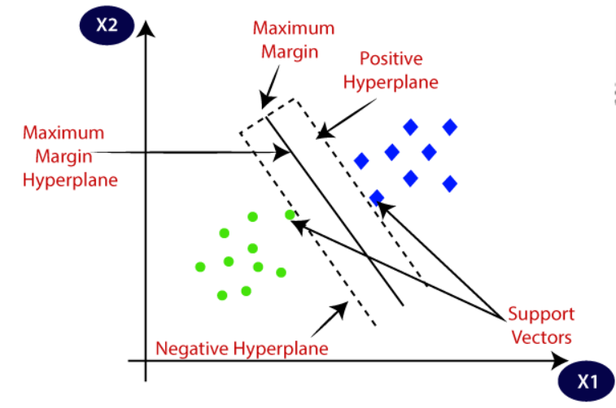
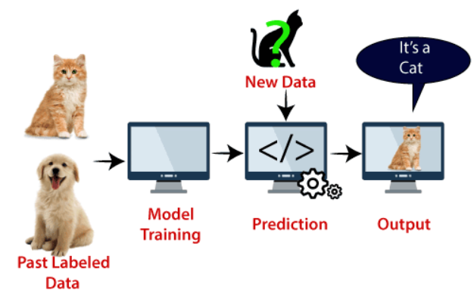
Support Vector Machine
Two different categories that are classified using a decision boundary or hyperplane:
17

Slide 21
Types of Support Vector Machine
Linear SVM: Linear SVM is used for linearly separable data, which means if a dataset can be classified into two classes by using a single straight line, then such data is termed as linearly separable data, and classifier is used called as Linear SVM classifier.
Non-linear SVM: Non-Linear SVM is used for non-linearly separated data, which means if a dataset cannot be classified by using a straight line, then such data is termed as non-linear data and classifier used is called as Non-linear SVM classifier.
18

Slide 22
What is Hyper Plane?
There can be multiple lines/decision boundaries to segregate the classes in n-dimensional space, but we need to find out the best decision boundary that helps to classify the data points. This best boundary is known as the hyperplane of SVM.
The dimensions of the hyperplane depend on the features present in the dataset, which means if there are 2 features (as shown in image), then hyperplane will be a straight line. And if there are 3 features, then hyperplane will be a 2-dimension plane.
We always create a hyperplane that has a maximum margin, which means the maximum distance between the data points.
19

Slide 23
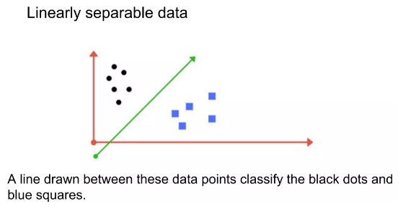
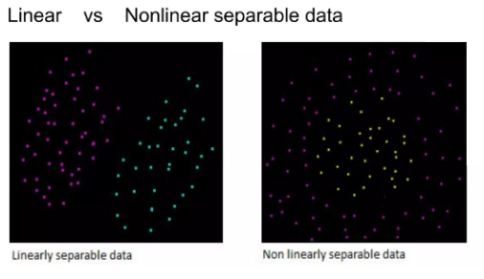
What is support vectors?
The data points or vectors that are the closest to the hyperplane and which affect the position of the hyperplane are termed as Support Vector. Since these vectors support the hyperplane, hence called a Support vector.
20

Slide 24
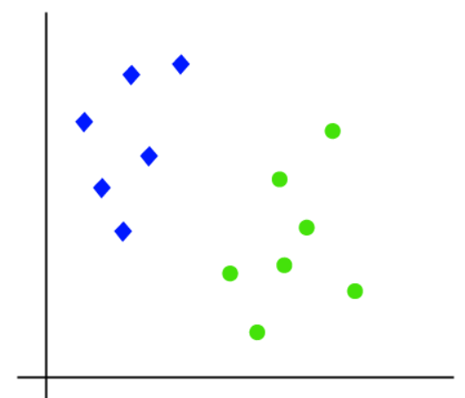
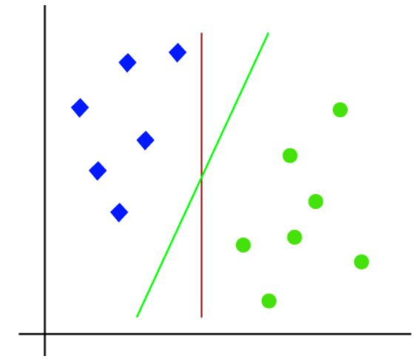
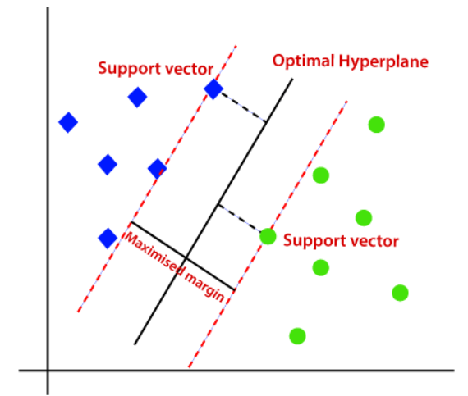
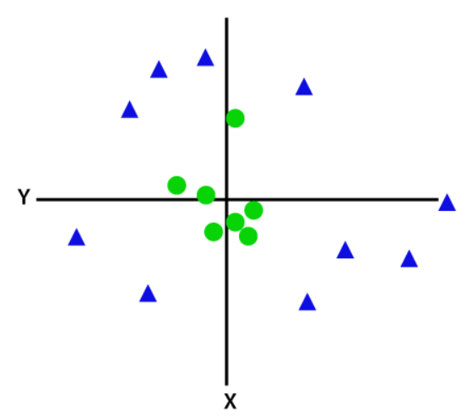
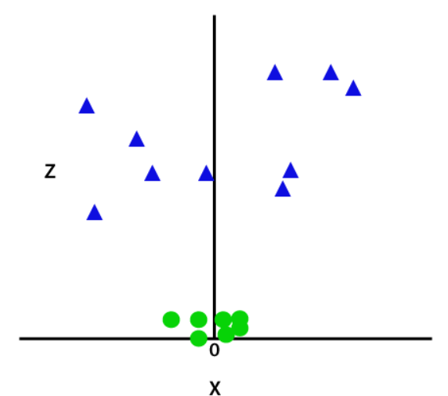
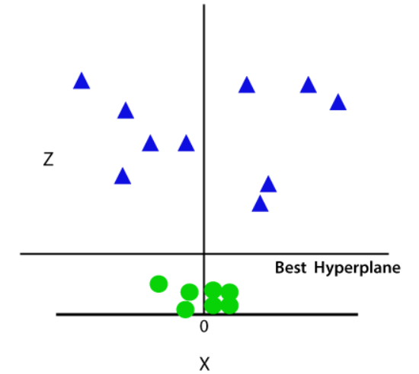
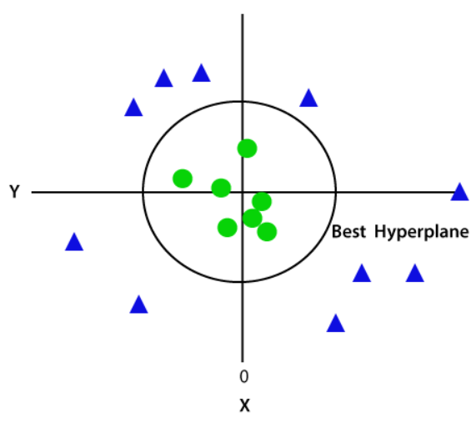
What is Logistic Regression?
Linear SVM:
Non-linear SVM:
21

Slide 25
Fine tuning parameters
Kernel
Regularization
Gamma
Margin
22

Slide 26
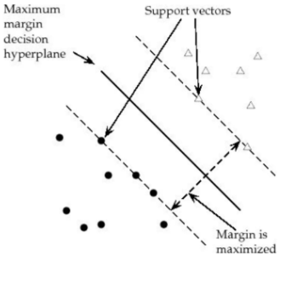
Margin
Margin is the perpendicular distance between the closest data points and the Hyperplane (on both sides) The best optimized line (hyperplane) with maximum margin is termed as Margin Maximal Hyperplane. The closest points where the margin distance is calculated are considered as the support vectors.
23

Slide 27
Regularization
Also the 'C' parameter in Python's SkLearn Library
Optimises SVM classifier to avoid misclassifying the data.
C→ large Margin of hyperplane → small
C→ small Margin of hyperplane → large
misclassification(possible)
1. C--> large, chance of overfit
2. C--> small, chance of underfitting
24

Slide 28
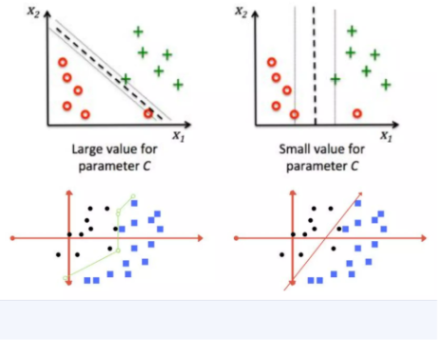
Regularization
25

Slide 29
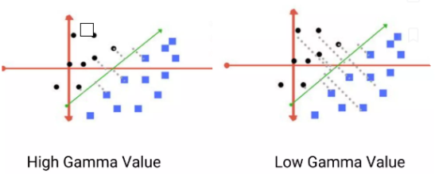
Gamma
Defines how far influences the calculation of of plausible line of separation.
• Low gamma ---> points far from plausible line are considered for calculation
• High gamma -----> points close to plausible line are considered for calculation
26

Slide 30
Kernels
Mathematical functions for transforming data using some linear algebra
Different SVM algorithms use different types of kernel functions
Various kernels available
Linear Kernel
Non-linear Kernel
Radial Basis Function(RBF)
Sigmoid
Polynomial
Exponential
27

Slide 31
Let’s dock this study with defence scenario
We are classifying soldiers into Low/Medium/High cold-injury risk, based on personal & environmental factors, using SVM as the demo ML model.
Imagine soldiers deployed in Kashmir-type high-altitude borders during harsh winters.
Some soldiers develop cold-related injuries (frostbite, hypothermia).
Officers want a predictive model that, given certain risk factors, can classify a soldier’s risk level (Low / Medium / High).
28

Slide 32
What we classify using this model?
The model’s output (target variable = risk_level) is a classification of risk:
Low risk – soldier unlikely to get cold-related injuries
Medium risk – moderate probability
High risk – soldier is very vulnerable and requires preventive action (better gear, less exposure, medical monitoring)
29

Slide 33
Input features used for classification
Age – younger vs older soldiers may differ in resilience
BMI – body fat influences cold resistance
Cold gear quality – good / average / poor (categorical)
Exposure hours – how long soldier is exposed to harsh conditions
Previous injury – if already injured, risk is higher
Snow depth – proxy for how extreme the environment is
30

Slide 34
How this model helps with defence group?
Officers can input soldier details manually in the developed model to observe the results
The ML model instantly classifies the risk level.
They can experiment with parameters (e.g., increasing exposure hours, lowering gear quality) to see how risk changes.
31

Slide 35
Hands-on: Demo
Hands-on code to explore SVM model using causalities winter dataset
32

Slide 36
Naïve Bayes Algorithm

Slide 37
What is Naïve Bayes?
Naive Bayes is a family of simple yet powerful probabilistic classifiers based on Bayes’ Theorem with a strong assumption of feature independence.
Its key feature is a "naive" assumption that all the features used for prediction are independent of each other.
For new data, the classifier calculates the probability of that data belonging to each class, and the class with the highest probability is assigned.
16

Slide 38
Intuition & Analogy
Instead of trying to learn complex decision boundaries, it uses probability to decide which class a data point most likely belongs to.
Analogy:
Think of a doctor diagnosing flu: symptoms like fever, cough, and sore throat are considered independent, and the diagnosis is based on the probability of flu given those symptoms.
16

Slide 39
Why Naïve Bayes?
Fast and efficient: Works well with large datasets.
Low computational cost: Requires fewer parameters to estimate.
Works well with text data: Excellent for Natural Language Processing tasks like spam filtering and sentiment analysis.
Robust to irrelevant features: Even if some features are not important, it still performs decently.
Handles multiclass classification naturally.
16

Slide 40
Real-time applications of NB
Email spam detection → classifying emails into spam or not spam.
Sentiment analysis → positive, negative, or neutral reviews.
Medical diagnosis → predicting disease based on symptoms.
Document categorization → news article classification (sports, politics, technology).
Recommender systems → predicting user preferences.
16

Slide 41
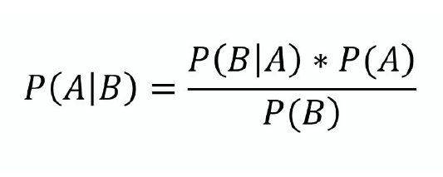
Bayes Theorem
A = Class (e.g., spam / not spam).
B = Features (words in an email).
P(A|B) = Posterior probability → probability of class given the data.
P(B|A) = Likelihood → probability of data given the class.
P(A) = Prior → probability of class before seeing the data.
P(B) = Evidence → probability of the data (acts as normalization).
👉 In Naive Bayes, we maximize P(A|B) and choose the class with the highest probability.
16

Slide 42
Steps of the Naïve Bayes Process
Prepare Data
Collect dataset (categorical, text, or numerical).
Preprocess (clean, tokenize, vectorize).
Calculate Priors
Probability of each class (e.g., spam = 40%, not spam = 60%).
16

Slide 43
Steps of the Naïve Bayes Process
Calculate Likelihoods
Probability of each feature given a class (e.g., word “free” given spam).
Apply Bayes’ Theorem
Multiply likelihoods × prior.
Choose Class
Select the class with the highest posterior probability.
16

Slide 44
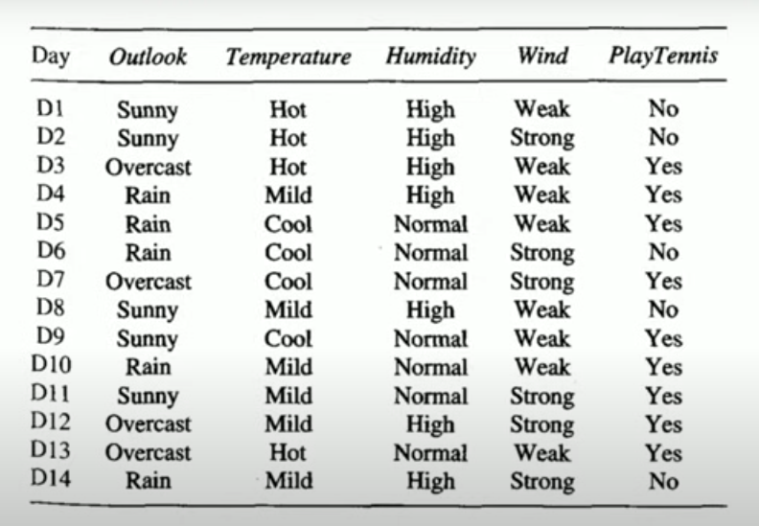
Simple scenario to get connect
Let’s take this benchmark scenario to understand the Naïve Bayes process
Here in this dataset, we’ve totally 5 features (Outlook, temperature, Humidity, Wind, Play Tennis)
Input features are : Outlook, temperature, Humidity, Wind
Output feature is: PlayTennis
16

Slide 45
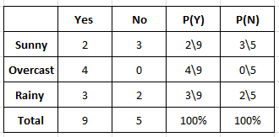
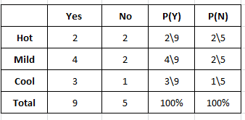
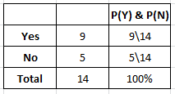
Let’s take 2 features and play around
OUTLOOK
TEMPERATURE
Play Tennis
16

Slide 46
Let’s Compute
Today (Sunny, Hot) -> He’s going to play or not
P( Yes | Today ) = P (Sunny | Yes) * P (Hot | Yes) * P (Yes)
P (Today)
(2/9) * (2/9) * (9/14) = 0.031
P( No| Today ) = P (Sunny | No) * P (Hot | No) * P (No)
P (Today)
(3/5) * (2/5) * (5/14) = 0.08571
16

Slide 47
Let’s Normalize it
P (Yes) = 0.031 / (0.031 + 0.08571) = 0.27
P (No) = 1 – 0.27 = 0.73
Today (Sunny | Hot) = No (i.e) 73% prob is not to play today
16

Slide 48
Types of Naïve Bayes
Gaussian Naïve Bayes:
Used when features are continuous and follow a normal distribution.
Features are continuous (real-valued) and roughly normally distributed within each class (or close enough after transform).
Examples: sensor readings, blood pressure, exam scores.
16

Slide 49
Types of Naïve Bayes
Multinomial Naïve Bayes:
Used for discrete counts.
Discrete count data (e.g., number of times each word appears in a document). Very common for document classification, spam detection, topic classification. (i.e)
Example: Whether the documents is belongs to sports, technical or politics, etc. based on the words counts in the documents.
16

Slide 50
Types of Naïve Bayes
Bernoulli Naïve Bayes:
Used for binary features (yes/no, 0/1).
It’s similar to multinomial NB but the predictors are boolean values.
Example: whether a word appears in a document or not.
16

Slide 51
Pros and cons
Pros:
Simple, fast, and easy to implement.
Works well with high-dimensional data (e.g., text classification).
Requires small training data compared to other models.
Robust to irrelevant features.
16

Slide 52
Pros and cons
Cons:
Assumption of independence rarely holds in real-world data.
Struggles when features are correlated.
If a category has zero frequency, probability becomes zero (zero-frequency problem).
Not always the most accurate compared to modern models like Random Forests or Neural Networks.
16

Slide 53
Let’s dock it with defence scenario
Scenario:
Predict whether a soldier is Safe or Risky during patrols, based on equipment usage and operational conditions.
This is a binary classification problem.
ML model learns patterns from past data:
If soldier has all protective gear + short patrol in plains → Safe
If soldier lacks vest + 8 hrs night patrol in mountains → Risky
16

Slide 54
Dataset Features Breakdown
helmet_worn → yes/no -> Wearing a helmet reduces head injury risk.
bulletproof_vest → yes/no -> Vest improves survivability against small arms.
communication_device → yes/no -> Radio or comm device ensures help can be called in emergencies.
night_patrol_hours → numeric (0–10) -> Longer night patrols → higher fatigue & risk.
terrain → categorical (plains, forest, mountain, urban) -> Some terrains (mountain, urban) pose more danger.
Target (Output)
safety_status → Safe / Risky
16

Slide 55
How this helps with officers?
Operational Readiness → Helps commanders quickly identify if patrol teams are adequately equipped.
Preventive Measures → Early detection of risky patterns (e.g., too many night hours without gear).
Policy Enforcement → Demonstrates how data + ML can enforce compliance with SOPs (Standard Operating Procedures).
Interactive Training → Officers can “test” different gear combinations in your demo and instantly see the ML model’s verdict.
16

Slide 56
Hands-on: Demo
Yet to add
32

Slide 57
K-means Clustering

Slide 58
What is K-means Clustering?
K-means is an unsupervised clustering algorithm that partitions data into K groups (clusters) based on feature similarity.
Instead of predicting labels, it tries to discover structure in data by grouping similar data points.
“K” = number of clusters we want.
“Means” = each cluster is represented by the mean (centroid) of its points.
16

Slide 59
Key Idea behind the algorithm
Imagine you have a bunch of scattered points on paper. K-Means tries to draw circles around groups of points such that the points inside each circle are similar. The circle’s center is the centroid.
Group similar data points together and represent each group by its centroid.
16

Slide 60
Why K-means Clustering?
Easy to implement → Only a few steps, very intuitive.
Scalable → Can handle thousands or millions of points efficiently.
Useful for hidden patterns → Often we don’t know how data is structured. K-Means helps us find natural groupings.
Exploratory tool → Especially when you have raw data and want to see if there are “types” of things (customers, products, behaviors).
16

Slide 61
Real time applications
Market Segmentation:
Retailers group customers into “budget shoppers”, “premium buyers”, etc., based on spending habits.
Image Compression:
A photo with millions of colors can be compressed to fewer color clusters (e.g., 16), reducing file size.
Document Clustering:
Automatically grouping research papers by topics (AI, biology, economics).
Anomaly Detection:
If most points fit into neat clusters but some fall far away → those are outliers (useful in fraud detection).
Recommendation Systems:
Grouping users with similar preferences helps recommend movies, products, or songs.
16

Slide 62
Steps of K-means process
Choose K → Suppose we want 3 clusters.
Randomly initialize centroids → Place 3 “X” marks randomly in the data space.
Assign points to nearest centroid → Each point joins the cluster with the closest centroid.
Update centroids → For each cluster, take the mean of its points → this becomes the new centroid.
Repeat → Reassign → Update centroids → until centroids don’t move much (convergence).
Analogy: Think of it like students sitting around 3 group leaders in a classroom. Students keep switching chairs until everyone is closest to their leader.
16

Slide 63
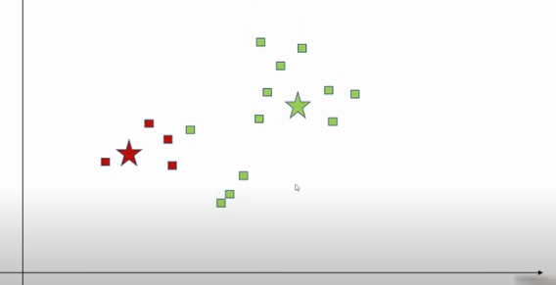
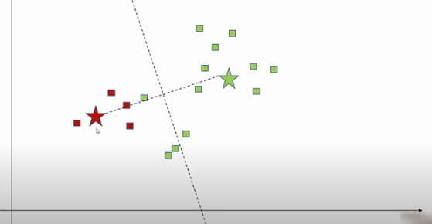
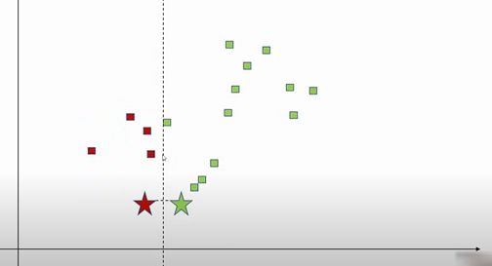
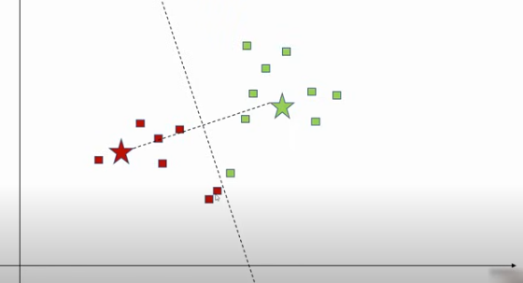
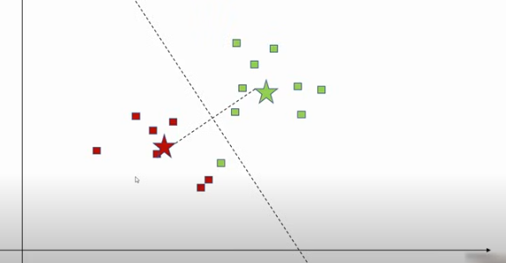
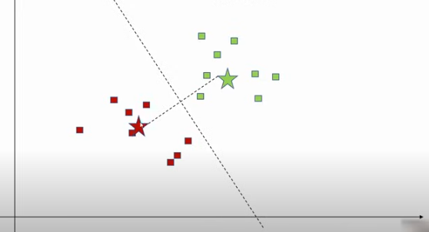
Exact assignments of centroids and it’s process
16

Slide 64
How to determine the right clusters?
Elbow Method:
It’s metric used in K-Means clustering to evaluate the compactness of clusters and determine the optimal number of clusters.
Plot Within-Cluster Sum of Squares (WCSS) vs Number of Clusters (K).
SSE – Sum of Squared Error – Consider k=2 and compute the distance of all the data points within the cluster and square it and sum it up.
WCSS: How close points are to their centroids.
As K increases, WCSS decreases.
At some point, the reduction slows → curve bends → “elbow” point = optimal K.
16

Slide 65
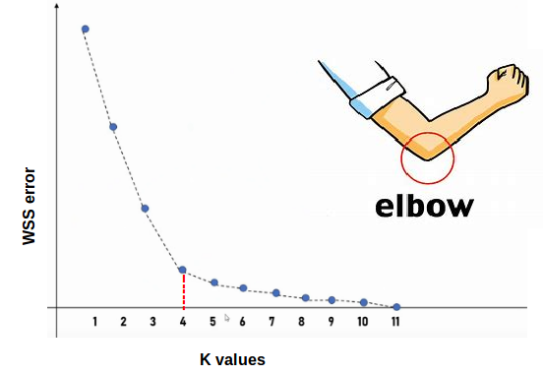
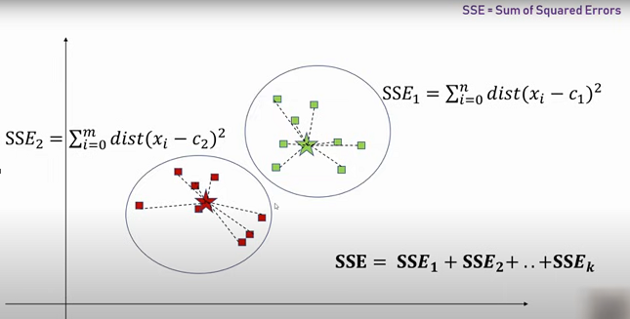
How to determine the right clusters?
Elbow Method:
Picture 1: How we’re computing the “Sum of Squared Errors” using
the equations.
Picture 2: It’s elbow graph, how we’re plotting the WCSS vs K values
16

Slide 66
K-means – Step by Step Process
Initial Setup
Data Points (12): (2,10), (2,5), (8,4), (5,8), (7,5), (6,4), (1,2), (9,9), (4,7), (3,6), (8,8), (6,7)
Chosen initial centroids:
Centroid 1 → (2,10)
Centroid 2 → (8,4)
16

Slide 67
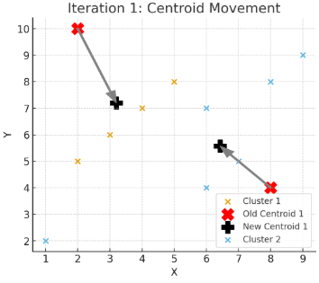
K-means – Step by Step Process
Iteration 1
Assign each point to the nearest centroid.
After assignment:
Cluster 1 (Centroid = (2,10)) → (2,10), (2,5), (5,8), (1,2), (4,7), (3,6), (6,7)
Cluster 2 (Centroid = (8,4)) → (8,4), (7,5), (6,4), (9,9), (8,8)
Compute new centroids:
Cluster 1 → Average = (3.3, 6.4)
Cluster 2 → Average = (7.6, 6.0)
16

Slide 68
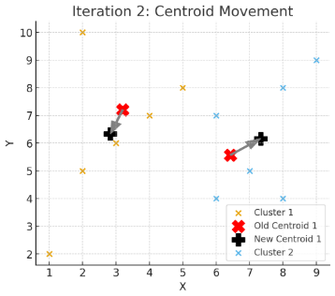
K-means – Step by Step Process
Iteration 2
Reassign points using new centroids.
New assignments:
Cluster 1 (Centroid = (3.3, 6.4)) → (2,10), (2,5), (5,8), (1,2), (4,7), (3,6)
Cluster 2 (Centroid = (7.6, 6.0)) → (8,4), (7,5), (6,4), (9,9), (8,8), (6,7)
Compute new centroids:
Cluster 1 → Average = (2.8, 6.3)
Cluster 2 → Average = (7.3, 6.3)
16

Slide 69
Let’s dock it with defence scenario
Scenario: Enemy Territory Understanding
When Indian forces monitor border or cross-border zones, they often have partial and noisy data:
Number of enemy movements spotted
Frequency of explosions/blasts/heavy fire
Drone activity (enemy surveillance)
Presence of supply lines or camps
This data does not come with labels (you don’t know in advance if an area is hostile or not).
16

Slide 70
What ML does here?
We use unsupervised learning (clustering) — e.g., KMeans — to group regions into categories based on observed patterns.
Example clusters:
Safe Zone → low enemy movement, no explosions, no drones.
Suspicious Zone → moderate activity, occasional drones, some supply lines.
Hostile Zone → frequent explosions, continuous movement, strong drone activity.
16

Slide 71
What we’ll classify?
In this scenario, the algorithm classifies areas into 3 groups:
0 → Safe Zone (low threat, patrol normally)
1 → Suspicious Zone (increase surveillance, prepare for escalation)
2 → Hostile Zone (high alert, probable attack, need reinforcement).
So the classification outcome tells commanders how to allocate troops and resources:
Quick Bite:
This scenario is not about predicting the exact enemy plan but about classifying border areas into Safe / Suspicious / Hostile categories using clustering → which directly supports resource deployment & safety of soldiers.
16

Slide 72
Let’s jump into hands-on
Basic Structure with Synthetic dataset:
Defence Based Dataset:
16

Slide 73
Thank You

